Slide 1
CHAPTER 2
INHERITANCE, CLASS & ID

Slide 2



HOMEWORK
INDIV
Back to
homework…

Slide 3



QUIZ
15 MIN
CLASS
<QUIZ>

Slide 4
QUIZ
WHAT IS THE CSS RULE TO :
Set a quote in bold
q {font-style : bold;}
p {font-style : bold;}
p {font-weight : bold}
q {font-weight : bold;}

Slide 5
QUIZ
WHAT IS THE CSS RULE TO :
Set a quote in bold
q {font-style : bold;}
p {font-style : bold;}
p {font-weight : bold}
q {font-weight : bold;}

Slide 6
QUIZ
WHAT IS THE CSS RULE TO :
Center h2
h2 {position : center;}
h2 {align : center;}
h2 {text-align : center;}
h2 (position : center;)

Slide 7
QUIZ
WHAT IS THE CSS RULE TO :
Center h2
h2 {position : center;}
h2 {align : center;}
h2 {text-align : center;}
h2 (position : center;)

Slide 8
QUIZ
WHAT IS THE CSS RULE TO :
All elements in Arial
And h3 in italic
1. body {font-family : Arial;}
h3 {font-style : italic;}
2. body {font-family : Arial;
font-syle : italic;}
3. html {font-family : Arial;}
h3 {font-weight : italic;}
4. p {font-family : Arial;
h3 {font-weight : italic;}

Slide 9
QUIZ
WHAT IS THE CSS RULE TO :
All elements in Arial
And h3 in italic
1. body {font-family : Arial;}
h3 {font-style : italic;}
2. body {font-family : Arial;
font-syle : italic;}
3. html {font-family : Arial;}
h3 {font-weight : italic;}
4. p {font-family : Arial;
h3 {font-weight : italic;}

Slide 10
QUIZ
HTML element used to include an external style sheet.
<style> </style>
<link ………/>
<meta ……./>
<style …… />

Slide 11
QUIZ
HTML element used to include an external style sheet.
<style> </style>
<link ………/>
<meta ……./>
<style …… />

Slide 12
INHERITANCE

Slide 13
EXPLORE
15 MIN
CLASS
Which rule is the best to have all texts in GREEN ?
<body>
<h1> PNC Aerobic Club </h1> <p> I am happy to welcome you in <strong> this page </strong> </p> <p> As our teacher often says <q>aerobic is a great activity </q> </p> <h2> What is aerobic? </h2>
<p> Aerobics is a sport <a href=http://en.wikipedia.org/>Wikipedia </a> </p>
<h3> Come join us! </h3>
</body>
1
2
h1,h2,h3,p,a,strong,q {
color: green;
}
body {
color: green;
}

Slide 14
EXPLORE
Which rule is the best to have all texts in GREEN ?
<body>
<h1> PNC Aerobic Club </h1> <p> I am happy to welcome you in <strong> this page </strong> </p> <p> As our teacher often says <q>aerobic is a great activity </q> </p> <h2> What is aerobic? </h2>
<p> Aerobics is a sport <a href=http://en.wikipedia.org/>Wikipedia </a> </p>
<h3> Come join us! </h3>
</body>
1
2
h1,h2,h3,p,a,strong,q {
color: green;
}
body {
color: green;
}
every children of body
will be green !

Slide 15
EXPLORE
What will be the color of ‘I am happy’ ?
<body>
<h1> PNC Aerobic Club </h1> <p> I am happy to welcome you in <strong> this page </strong> </p> <p> As our teacher often says <q> aerobic is a great activity </q> </p> <h2> What is aerobic? </h2>
<p> Aerobics is a sport <a href=http://en.wikipedia.org/>Wikipedia </a> </p>
<h3> Come join us! </h3>
</body>
body {
color: green;
}
p {
color : red;
}
1
2
3
4
GREEN
RED
BLACK
BLUE

Slide 16
EXPLORE
What will be the color of ‘I am happy’ ?
<body>
<h1> PNC Aerobic Club </h1> <p> I am happy to welcome you in <strong> this page </strong> </p> <p> As our teacher often says <q> aerobic is a great activity </q> </p> <h2> What is aerobic? </h2>
<p> Aerobics is a sport <a href=http://en.wikipedia.org/>Wikipedia </a> </p>
<h3> Come join us! </h3>
</body>
body {
color: green;
}
p {
color : red;
}
1
2
3
4
GREEN
RED
BLACK
BLUE

Slide 17
EXPLORE
What will be the color of ‘this page’ ?
<body>
<h1> PNC Aerobic Club </h1> <p> I am happy to welcome you in <strong> this page </strong> </p> <p> As our teacher often says <q> aerobic is a great activity </q> </p> <h2> What is aerobic? </h2>
<p> Aerobics is a sport <a href=http://en.wikipedia.org/>Wikipedia </a> </p>
<h3> Come join us! </h3>
</body>
body {
color: green;
}
p {
color : red;
}
1
2
3
4
GREEN
RED
BLACK
BLUE

Slide 18
EXPLORE
What will be the color of ‘this page’ ?
<body>
<h1> PNC Aerobic Club </h1> <p> I am happy to welcome you in <strong> this page </strong> </p> <p> As our teacher often says <q> aerobic is a great activity </q> </p> <h2> What is aerobic? </h2>
<p> Aerobics is a sport <a href=http://en.wikipedia.org/>Wikipedia </a> </p>
<h3> Come join us! </h3>
</body>
body {
color: green;
}
p {
color : red;
}
1
2
3
4
GREEN
RED
BLACK
BLUE

Slide 19
EXPLORE
What will be the color of ‘Wikipedia’ ?
<body>
<h1> PNC Aerobic Club </h1> <p> I am happy to welcome you in <strong> this page </strong> </p> <p> As our teacher often says <q>aerobic is a great activity </q> </p> <h2> What is aerobic? </h2>
<p> Aerobics is a sport <a href=http://en.wikipedia.org/> Wikipedia </a> </p>
<h3> Come join us! </h3>
</body>
body {
color: green;
}
p {
color : red;
}
1
2
3
4
GREEN
RED
BLACK
BLUE

Slide 20
EXPLORE
What will be the color of ‘Wikipedia’ ?
<body>
<h1> PNC Aerobic Club </h1> <p> I am happy to welcome you in <strong> this page </strong> </p> <p> As our teacher often says <q>aerobic is a great activity </q> </p> <h2> What is aerobic? </h2>
<p> Aerobics is a sport <a href=http://en.wikipedia.org/> Wikipedia </a> </p>
<h3> Come join us! </h3>
</body>
body {
color: green;
}
p {
color : red;
}
1
2
3
4
GREEN
RED
BLACK
BLUE

Slide 21
EXPLAIN
What is Inheritance ?
15 MIN
CLASS
html
p inherits from body properties
head
body
title
h1
img
p
h1
p
h3
q
a
q inherits from p properties

Slide 22
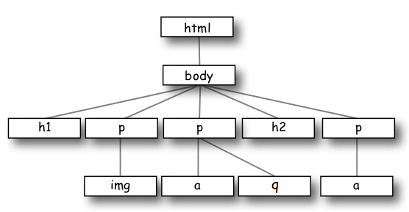
PRACTICE
Show on the graph which elements will be concerned by these rules :
body {
color : red
}
q {
color : green;
}

Slide 23
PRACTICE
Remove useless rule :
body {
font-family: sans-serif;
color: gray;
}
h1, h2 {
font-family: sans-serif;
}
p {
font-family: sans-serif;
color: red;
}

Slide 24
PRACTICE
Which element will be Sans-Serif ?
p {
font-family: sans-serif
}

Slide 25
PRACTICE
Which element will be green?
body {
color: green;
}
p {
color: black;
}

Slide 26
CLASS AND ID

Slide 27
GAME
What is a class ? What is an ID ? What is the difference ?
20 MIN
CLASS
<h1 class = « 2023C »
id = « student1 »>
<p id = « student2 »>
<p class = « 2023C»>

Slide 28
GAME
body {
color: blue;
}
.2023C {
color: yellow;
}

Slide 29
GAME
body {
color: blue;
}
#student1 {
color: green;
}
#student2 {
color: yellow;
}

Slide 30
GAME
body {
color: blue;
}
p.2023C {
color: green;
}

Slide 31
GAME
.2023C {
color: green;
}
#student1 {
color: yellow;
}

Slide 32
GAME
What is a class ? What is an ID ? What is the difference ?
20 MIN
CLASS
<h1 class = «music_club 2023C »
id = « student1 »>
<p class = « music club »
id = « student3 »>
<h1 class = « 2023B music_club»>
<h1 id = « student2 »

Slide 33
GAME
.2023C {
color: green;
}
.music_club {
text-align: center;
}

Slide 34
GAME
.2023C, 2023B {
color: green;
text-style: italic;
}
.music_club {
color: blue;
}

Slide 35
GAME
#student1, #student2{
color: yellow;
}
.2023C {
color: green;
}
.2023B {
text-syle: italic;
}
.music_club {
color: blue;
}

Slide 36
EXPLAIN
Rules
5 MIN
CLASS
1 element 1 ID
1 element 1 or more classes
1 class 1 or more elements
ID have the priority on class
If 2 class or more, the last one has the priority

Slide 37
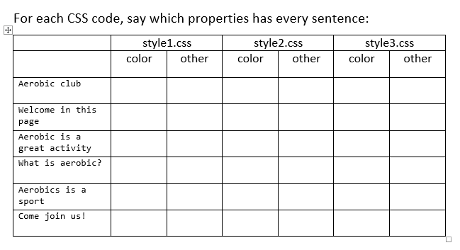
PRACTICE
15 MIN
INDIV
Activity 2

Slide 38
After class what to do ?
1. Read the handout I give you now.
2. Do the required homework
3. Send your homework to Google Classroom

